Slide 1

• Gathering the Requirements
• Test Document Preparation
• Testing Phases
• Software Test Plan
• Software Test Design
• Scope of the Testing
• Types of the Testing
• Test Execution
• Bug Tracking
• Result Analysis
• Reporting
• Delivery and Maintenance
• Test Summery Report

Slide 2
GgGathering the Requirements
--> Once the SRS Document is base lined (Completed), it will be sent to both developing team as well as testing team.
--> Testing team is responsible to review the SRS Document. While reviewing,if any unclear requirements (Doubts) are identified those will be updated into the document called “Review Report(RR)”.
--> The review report will be sent to the team lead where he will consolidate (Make one document) all the review reports to a single document called “Consolidated review report(CRR)”and it will be sent to the BA.
--> BA is responsible to Review all the unclear requirements and he will provide the clarifications then the “Updated Review report(URR)” will be sent to the testing team.
--> The testing team will again Review the URR with clarifications.
--> Once the testing team is very clear on all the requirements then they will take the test case template and write the test cases for all the requirements.
--> Once the testing team is very clear on all the requirements then they will take the test case template and write the test cases for all the requirements.

Slide 3
--> The test cases documents will be sent to the BA. Where he will review it and he will provide the comments whether any new test cases are needed to be added.
--> Based on BA comments the testing team will update the test cases.--> Once test cases are base lined (completed) it will be sent to the client for final review.
--> Once the build is released to the testing team, they will execute all the test cases on the Build.
--> While testing the build,if any Bugs are identified it will be reported (send) to the development team. Developer will fix it and send it back to the testing team for testing.
--> Test Engineer will test that whether the bug is really fixed or not and at the same time he will check for other bugs.
--> If identified it will be reported to the developer.
--> The same process will be continuing until the build is stable (Bug free or No Bugs).
--> The stable build will be delivered to the client.

Slide 4
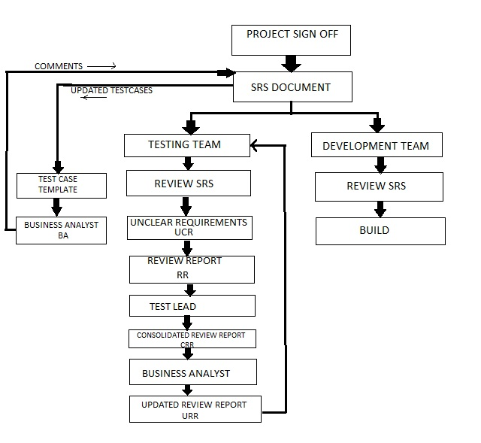

Slide 5
Test Document Preparation
Software Test Plan
Software Test Design
Text Execution
Result Analysis
Reporting
Delivery and Maintenance
Test Summary Report
--> Software Test Plan index:-
1. Objective
1.1 Scope of testing
2. Reference documents
3. Test Items
3.1 Features to be tested
3.2 Features not to be tested
4. Test strategy
4.1 Testing types
4.1.1 Functional testing types

Slide 6
5. Test environment
6. Test pass/Fail criteria
7. Defect analysis and closure
8. Test Deliverables
9. Automation testing
10. Risks and contingencies
11. Hardware and software requirements
12. Resource plan
13. Test summary report/ Build postmortem report.
--->Scope of the Testing:
What kind of testing's the testing team is responsible to test on the application is known as “Scope of the testing”.
EX:- Testing team is responsible for manual testing and automation for the project
--> Software Test Design:
The process of writing the test cases on the test case template after understanding all the requirements is known ‘software test design’.
Every organization will be having their own template based on that template; the test engineer is responsible to write the test cases.

Slide 7

Test case Template
We are having the below templates to write the test cases.
---> Test Execution:
1.The process of executing the test cases on the build in test environment is known as test execution. Whenever the build is released to the testing team the test engineer has to review the SRN document to know the build status.
2. Based on the SRN document the test lead will deploy the build and the testing team will perform sanity test.
3. Once the sanity test is completed, the sanity test results are emailed to the developer.
4. If sanity test is pass the testing team will continue to execute the test cases, if not the testing team will reject the build back to the development team.
5. While executing the test cases the test engineer will observe the actual behavior of the application for the scenario and it will be updated under the actual result field. The same will be continued for all the test cases.

Slide 8
---> Result analysis :-
While executing the test cases the test engineer will update
the actual result field then he will compare the actual result with expected result,
if both are matching then he will provide the result as pass else he will update as fail.
For pass we will give the green color, whereas for the fail we will provide red
color. Test execution and result analysis both are parallel process.
Note: Once the test case execution is complete we are responsible to execute all the types of
functional testing on the application to identify the bugs.
Levels of testing:
---> Functional Testing:
i)Manual Testing: In this type the tester takes over the role of an end
user and test the Software to identify any un-expected behavior or bug.There are different
Stages for manual testing like smoke testing, Integration testing, System testing and
Re testing, and regression testing.
ii)Automation Testing: The tester writes scripts and uses another software
to test the software. This process involves automation of a manual process. Automation
Testing is used to re-run the test scenarios that were performed manually, quickly
and repeatedly.
Automation tools: Selenium,QTP, etc.

Slide 9
--->Non-Functional Testing:
i)Performance Testing: It is mostly used to identify any bottlenecks or performance issues rather than finding the bugs in software.
Performance Testing tools: Loadrunner, Jmeter etc..
--->Reporting:-
The process of reporting/sending the bugs (failed test cases) to the developer is known as “Reporting”.
It is two types.
1. Reporting the Bugs by using XL files.
2. Reporting the bugs by using reporting tools.
1. Report the bugs by using XL file:
It was the old process we used to have the below template to update the bug and send it to the developer.

Slide 10

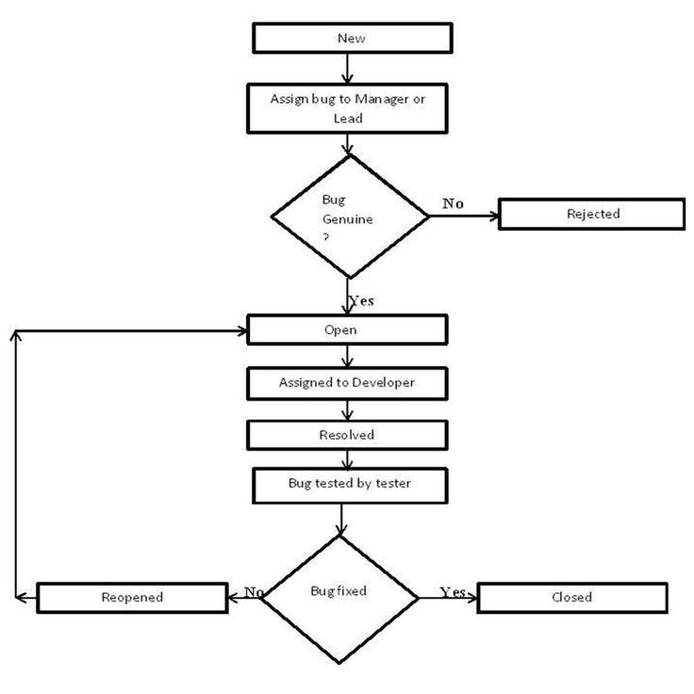
--> Bug Life Cycle:-

Slide 11
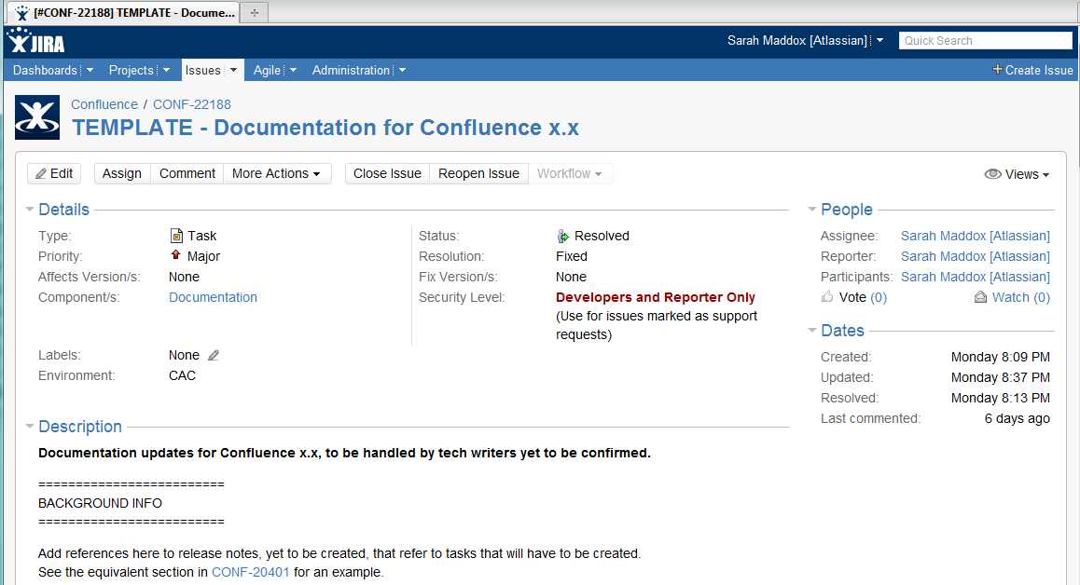
--> Report the bugs by using the reporting tools:
Ex: QC, JERA, Bugzilla, Test manager etc….

Slide 12
--->Test Report/Build status report:
Once the test case execution is completed on the build then test engineer is responsible to send a test report to the lead as well as client. It below format
Build status Report/Test Report
Test engineer name ________________
Build number 1
Login credentials
Browser FF, IE, Google chrome
Test Metrics
Total no. of test cases 200
No. of test cases executed 150
No. of test cases pending 50
No. of test cases pass 100
No. of test cases fail 50
No. of test cases skipped 10
No. of Bugs reported 20

Slide 13
--->Refer delivery and maintenance:
Once the build is successfully delivered to the client, the test lead prepare “test summary report” and it will be updated in test plan and the test plan send to the client.
--->

